Slide 1




Prediction of Vehicle Collision Severity using NYPD Data 2017
Kaviya Priya Kanakaraj
Haritha Pothapragada
Vyshali Prabananth Lal
Keerthana Rajendran

Slide 2
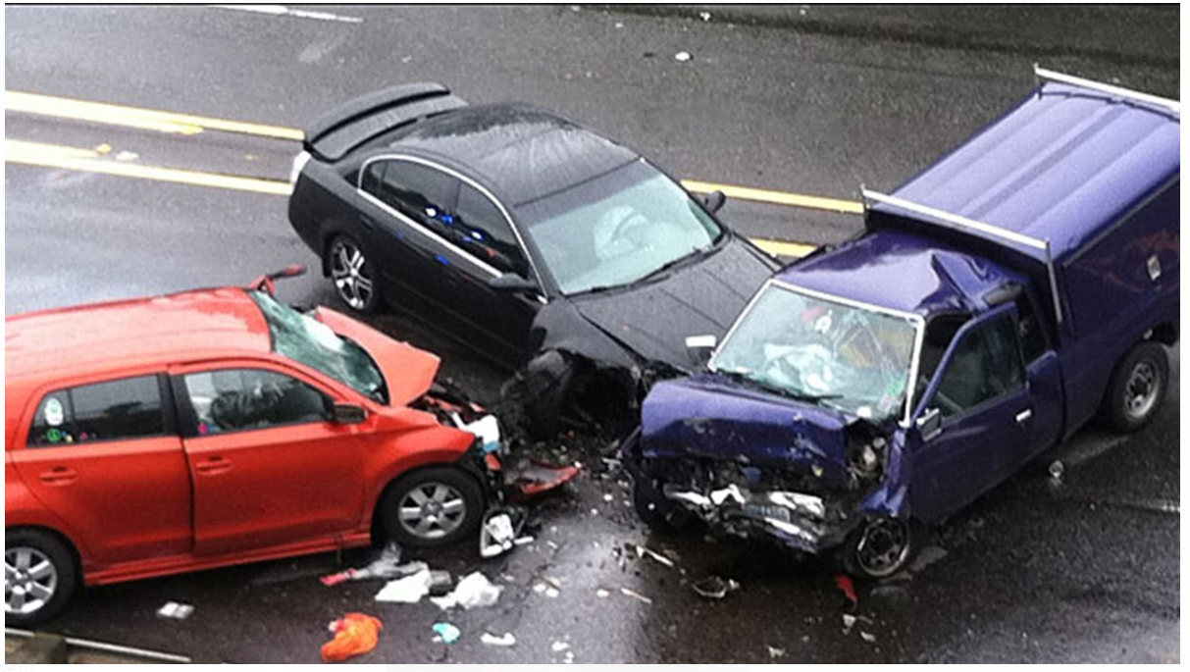
Introduction
Through the first five months of 2017, City Hall reported 5,577 injured, due to Motor Vehicle collision in NYC.
Data Link:-https://data.cityofnewyork.us/Public-Safety/NYPD-Motor-Vehicle-Collisions/h9gi-nx95
In Year 2017:-
Numbers of rows – 2,29,423
Number of columns-29 variables
Haritha

Slide 3
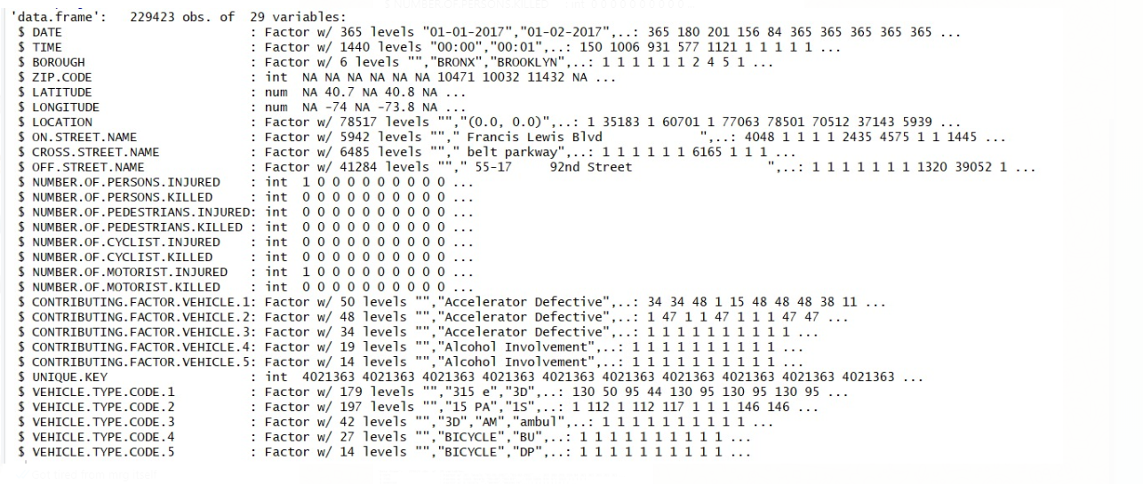
Insight of our data:-
Haritha

Slide 4
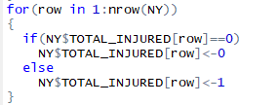
Data Cleaning
na.omit() → 137323 rows.
Time column categorized into 6 divisions:- T1-T6
Entire column removed –UNIQUE KEY.
Only month from the date column.
Added two columns named TOTAL KILLED and TOTAL INJURIED.
TOTAL KILLED= NUMBER.OF.PERSONS.KILLED+NUMBER.OF.PEDESTRIANS.KILLED+NUMBER.OF.CYCLIST.KILLED +NUMBER.OF.MOTORIST.KILLED
TOTAL INJURED=NUMBER.OF.PERSONS.INJURED+NUMBER.OF.PEDESTRIANS.INJURED+NUMBER.OF.CYCLIST.INJURED+ NUMBER.OF.MOTORIST.INJURED
As we wanted to predict if people are injured or not we categorized TOTAL INJURED into binary .
Kaviya

Slide 5
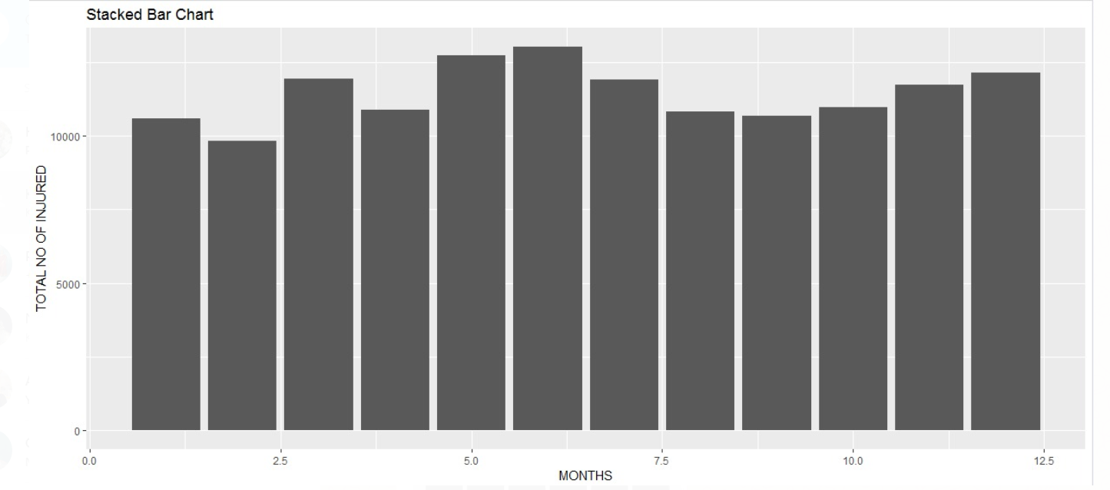
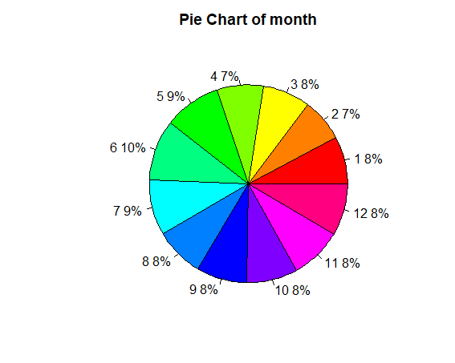
Exploratory Data Analysis
In statistics, exploratory data analysis (EDA) is an approach analyzing data sets to summarize their main characteristics, often with visual methods.
Total Injured Vs Month
Kaviya

Slide 6
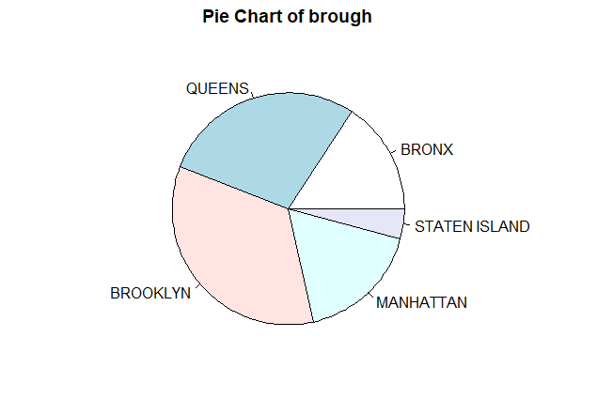
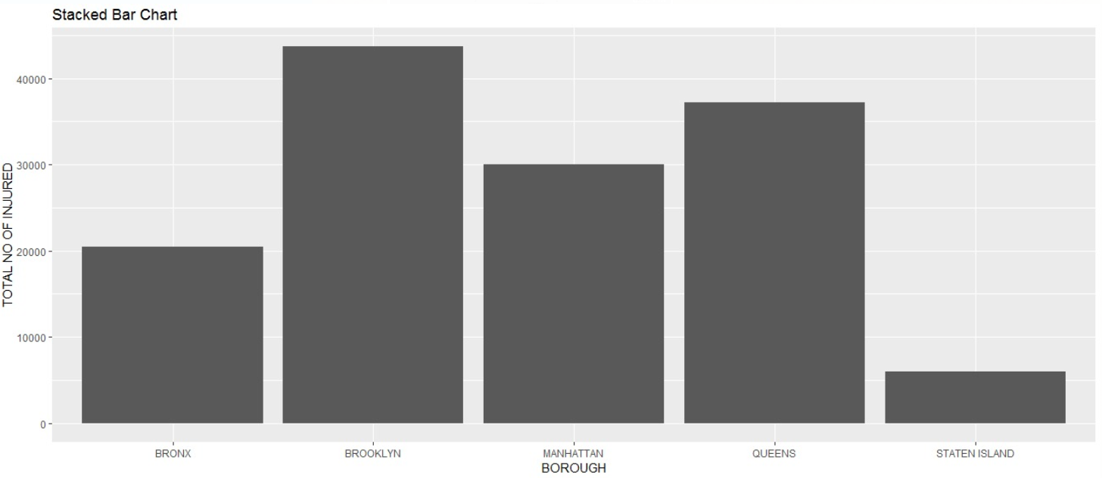
Total Injured Vs Borough
Kaviya

Slide 7
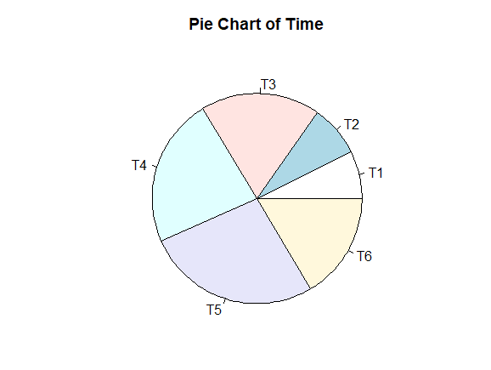
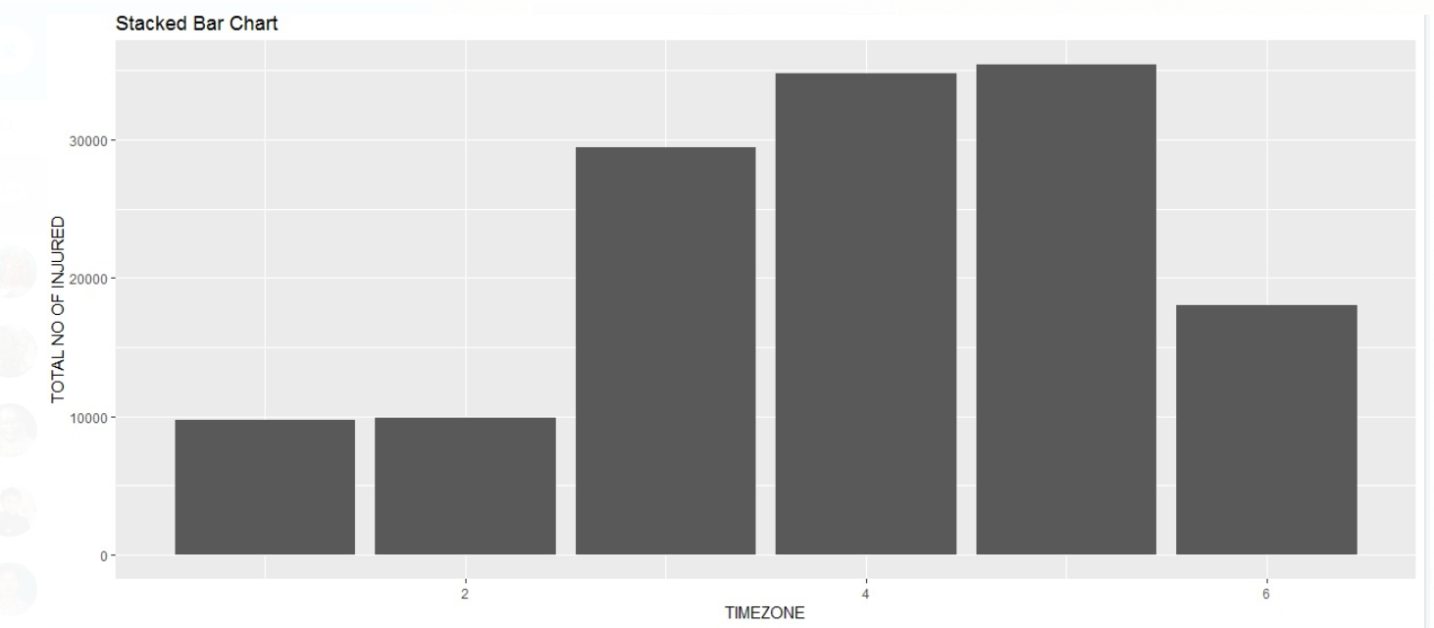
Total Injured Vs Time
Kaviya

Slide 8
METHODOLOGY
Random Forest
k-nearest neighbor
Artificial neural network
CART
C5.0
Naïve Bayes
Support Vector Machine
Kaviya

Slide 9
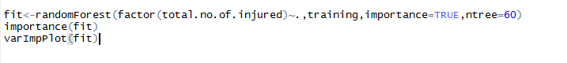
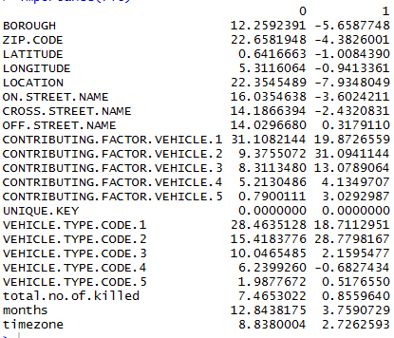
RANDOM FOREST
Collection of Decision Trees
Easy to measure the relative importance
of each feature on the prediction.
Feature Selection
Solved Over fitting problem
Limitation – large number of trees can make
the algorithm to slow and ineffective for
real-time predictions.
Kaviya

Slide 10
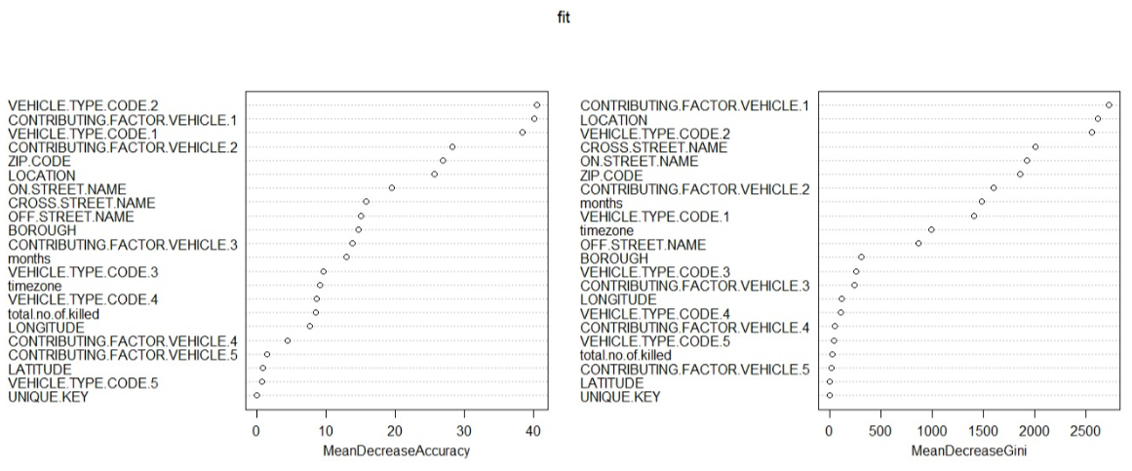
Random Forest
Importance Plot
ntree | Error Rate
50 | 14.873
60 | 14.604
90 | 14.803
100 | 14.633
Kaviya

Slide 11
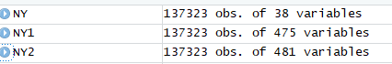
k-nearest neighbors
Though it is the simplest algorithm ,it was hard to apply for our data.
Data categorization for KNN
We converted the blanks in Contributing factors to unspecified and Vehicle code type to unknown.
To deal with columns with many levels/factors we used “one_hot()” .
knn works well with a small number of input variables but struggles when the number of inputs is very large.
K value | Error Rate
1 | 22.3355
2 | 16.81862
5 | 16.1224
10 | 14.9282
15 | 14.9369
Haritha

Slide 12
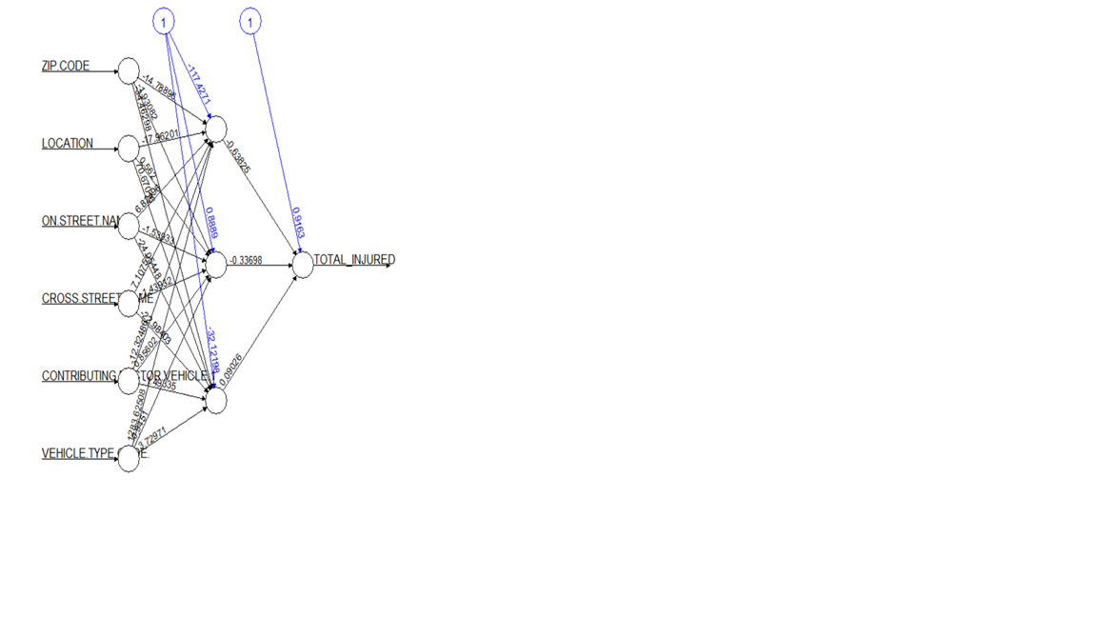
Artificial Neural Network
Converting with as.numeric() .
Normalizing the data using min-max :
(x - min(x))/(max(x)-min(x)
'the optimal size of the hidden layer is usually between the size of the input and size of the output layers'.
Hidden Layers | Threshold | Error Rate
1 | 0.01 | 18.1430
5 | 0.01 | 17.720
ntree=5
Haritha

Slide 13
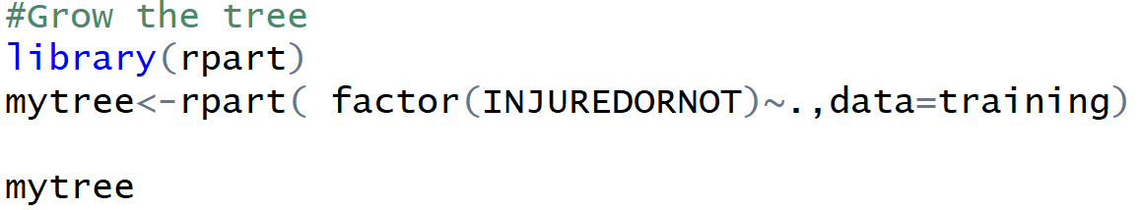
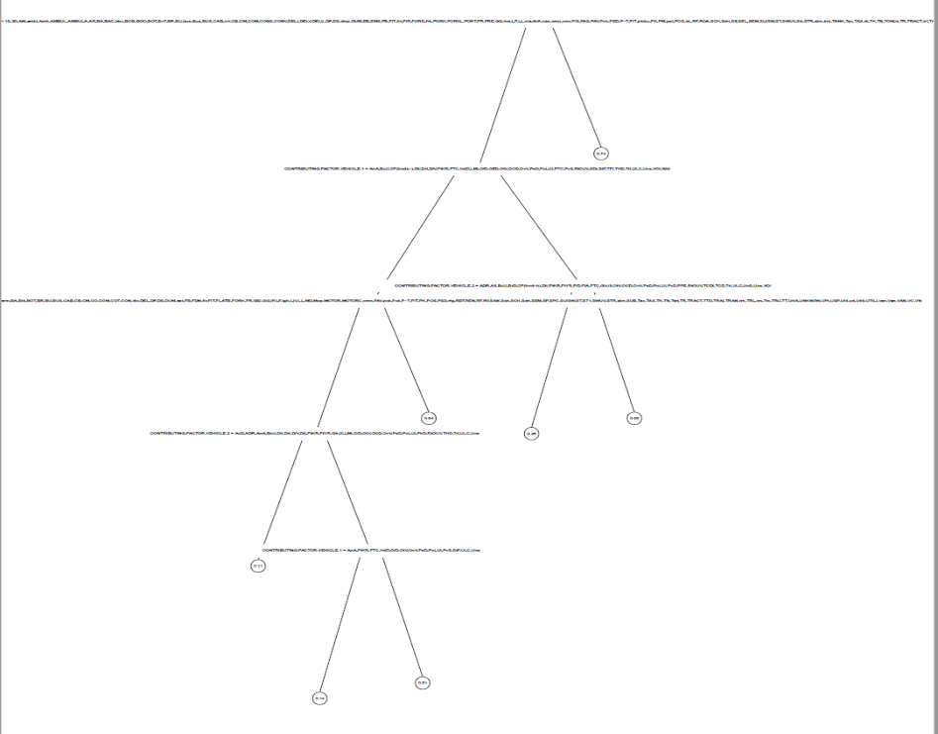
Decision Trees
CART- Classification And Regression Tree
The decision trees produced by CART are strictly binary, containing exactly two branches for each decision node
Even though the tree is binary it can split multiple levels or classes
A greedy approach is used to divide the space called recursive binary splitting
All possible splits are made and not all combinations
Then the optimal split is whichever1 split maximizes this measure Φ(s|t) over all possible splits at node t
The stopping criterion is that all the data points have the same value for the predictee (i.e., we have perfectly predicted its value for all data points)
Keerthana

Slide 14
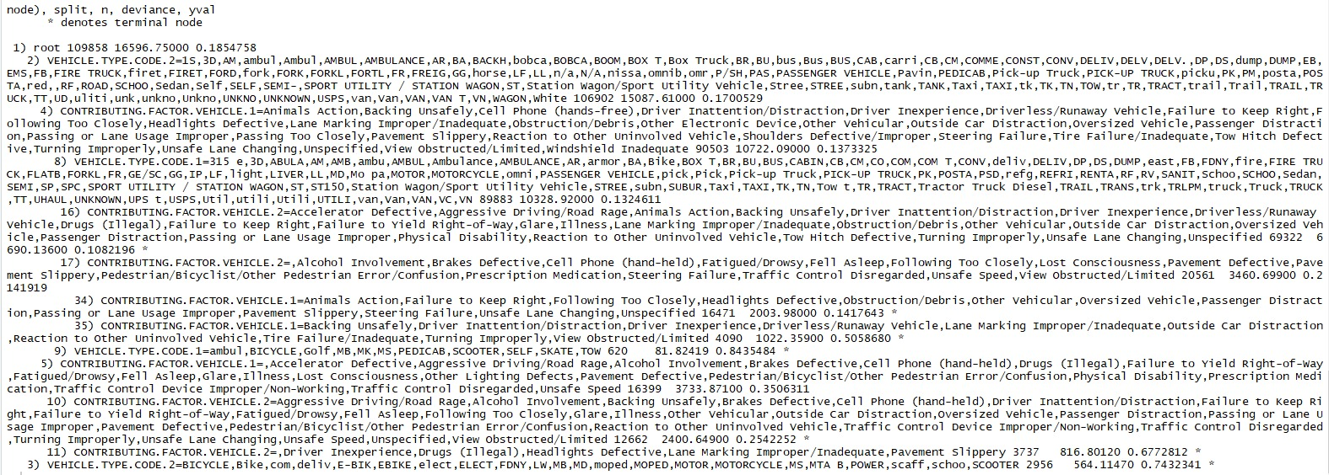
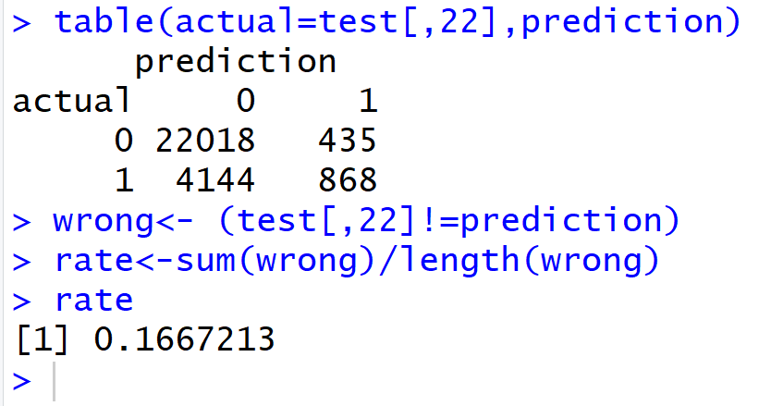
Decision Trees
CART- Classification And Regression Tree
Keerthana

Slide 15
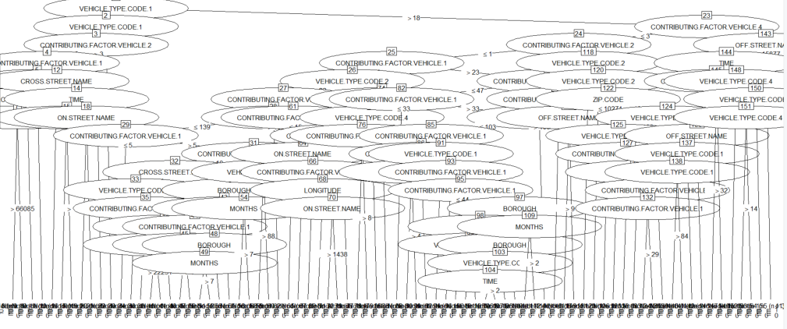
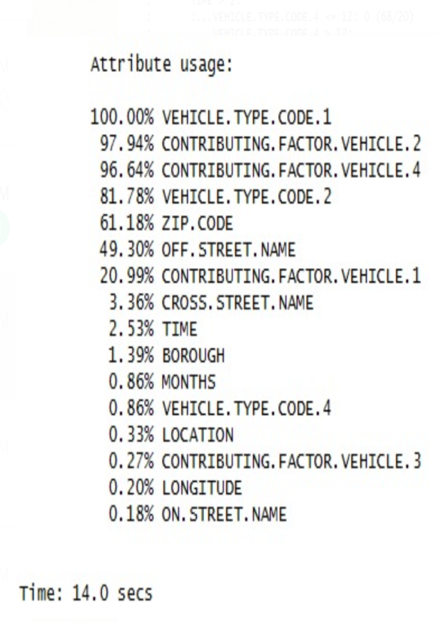
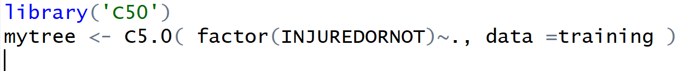
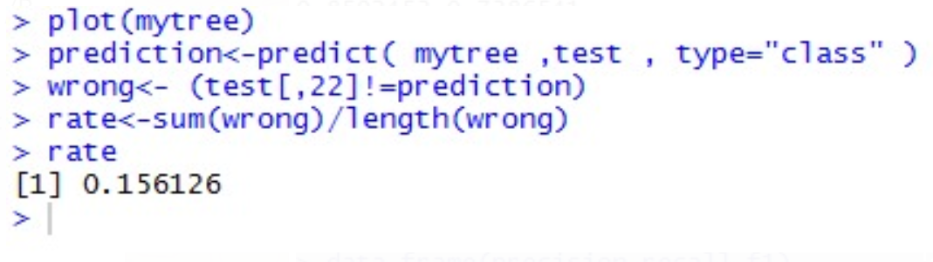
Decision Trees
C5.0
C 5.0 is an improvement on C4.5. The advantages are several orders of magnitude faster, memory efficiency, smaller decision trees, more accuracy, and ability to weight different attributes
Algorithm is not restricted to binary splits
In comparison C 5.0 performs better than CART
Keerthana

Slide 16

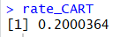
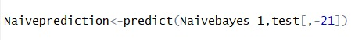
Naïve Bayes
All predictors have equal effect on outcome.
Algorithm learns the probability of object with certain features.
Calculates the probability of an event based on the previous knowledge available.
Achieved an accuracy of 80%.
Error Rate
Vyshali

Slide 17
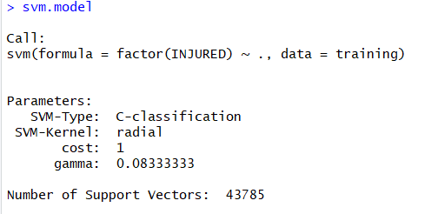
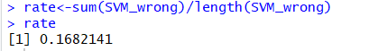
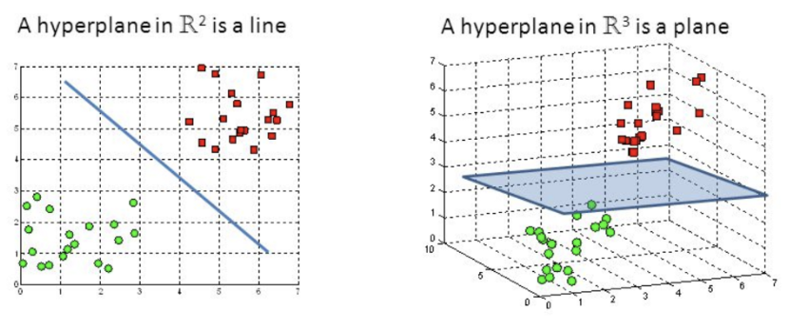
SVM
Data categorization for SVM
We converted the blanks in Contributing factors to unspecified and Vehicle code type to unknown.
Widely used in Classification Objectives.
Algorithm finds a Hyperplane in a N-dimensional plane. N-number of features
Used first 12 features from Random Forest. Run Time 4.5 hours approximately.
Vyshali

Slide 18
Results
Method | Error Rate
Random Forest | 14.604
KNN | 14.928
C5.0 | 15.612
CART | 16.672
SVM | 16.821
ANN | 17.720
Naïve Bayes | 20.000
Accuracy
85.39%
85.072%
84.388%
83.328%
83.179%
82.28%
80.000%
Keerthana

Slide 19
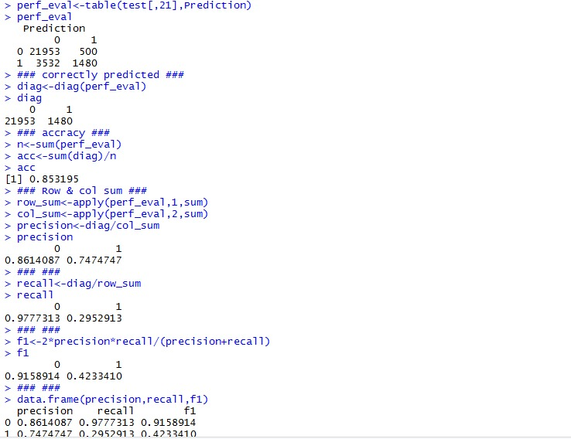
Performance Evaluation
For Random Forest
Keerthana

Slide 20
CONCLUSION
Random Forest works best
Useful for selecting Important features
Improved results for other methodologies
Keerthana

Slide 21
FUTURE WORKS
Prediction based Contributing Factors
Prediction of Contributing Factors help NYPD produce new law enforcement
Handling Missing Data
Correcting Spelling Mistakes in Text Variables
Vyshali

Slide 22

THANK YOU

